Slide 1

Exploratory Data Analysis
G2M Case Study
07-Aug-2021

Slide 2
Summary –G2M case study
XYZ is a private firm in US. Due to remarkable growth in the Cab Industry it is planning for an investment in Cab industry and as per their Go-to-Market(G2M) strategy they want to understand the market before taking final decision.

Slide 3
Problem Statement
To help XYZ firm in identifying the right company for making investment based on the insights after analyzing the data provided

Slide 4
Approach
Data exploration – study the data received for its features, number of columns, types of columns
Transform any columns as required
Check for missing values
Univariate analysis
Check numerical columns against dependent variable,Profit
Check categorical columns against Profit
Multivariate analysis
Scale the columns if required
Analyse the graphs obtained for insights

Slide 5
Data Exploration
4 files are used for analysis:
Cab_Data.csv – this file includes details of transaction for 2 cab companies
Customer_ID.csv – this is a mapping table that contains a unique identifier which links the
customer’s demographic details
Transaction_ID.csv – this is a mapping table that contains transaction to customer mapping
and payment mode
City.csv – this file contains list of US cities, their population and number of cab users
The 4 files are merged together using the common index to get the final dataset
Timeframe of the data: 2016-01-31 to 2018-12-31
Total data points :359392 and Total Columns :14
On checking we can confirm there are no missing values.
Columns like population and users should be converted to int values instead of object
Date of travel datetime variables should be in datetime format instead of int which gives the
advantage of extracting information from that.

Slide 6
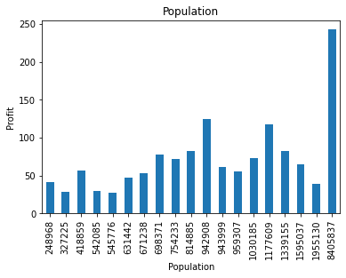
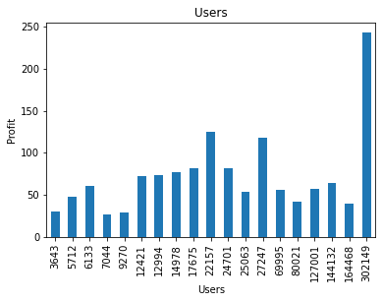
Profit Analysis
EDA
Profit analyzed with reference to Population and Users

Slide 7
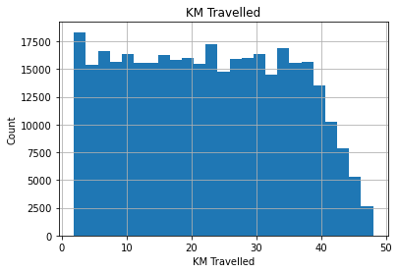
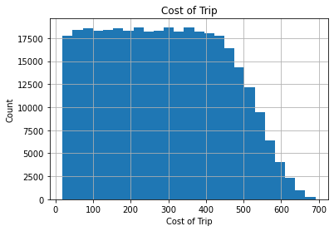
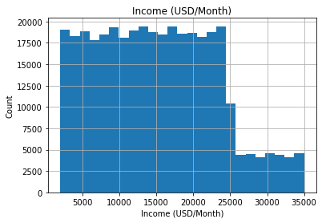
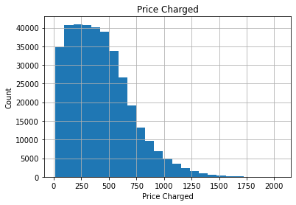
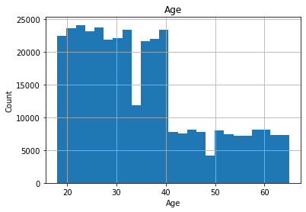
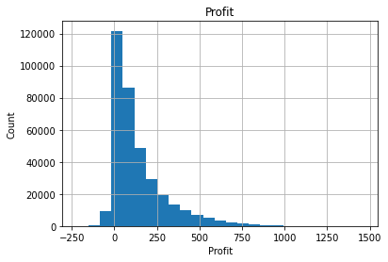
Profit Analysis
EDA
Profit analyzed with reference to Continous variables

Slide 8
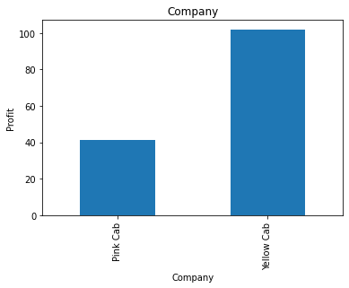
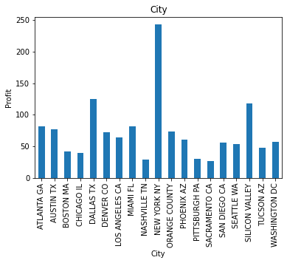
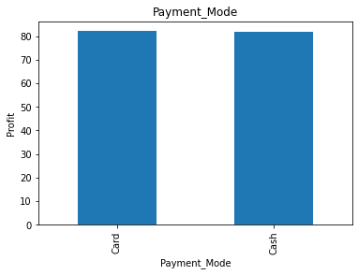
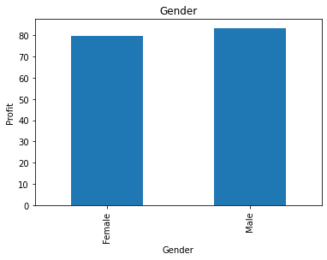
Profit Analysis
EDA
Profit analyzed with reference to Categorical variables

Slide 9
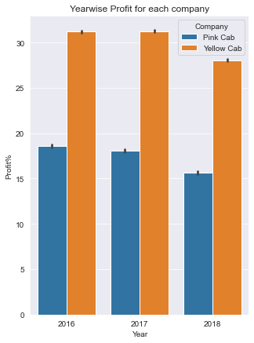
Multivariate Analysis
As per the graph obtained, we understand that Yellow cab has been more profitable for the last 3 years

Slide 10
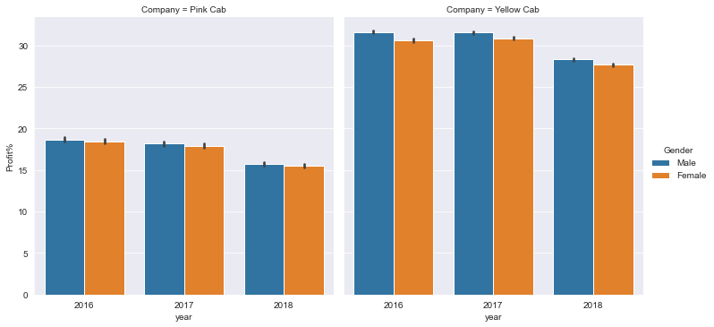
Multivariate Analysis
The gender data doesnt show much significant changes

Slide 11
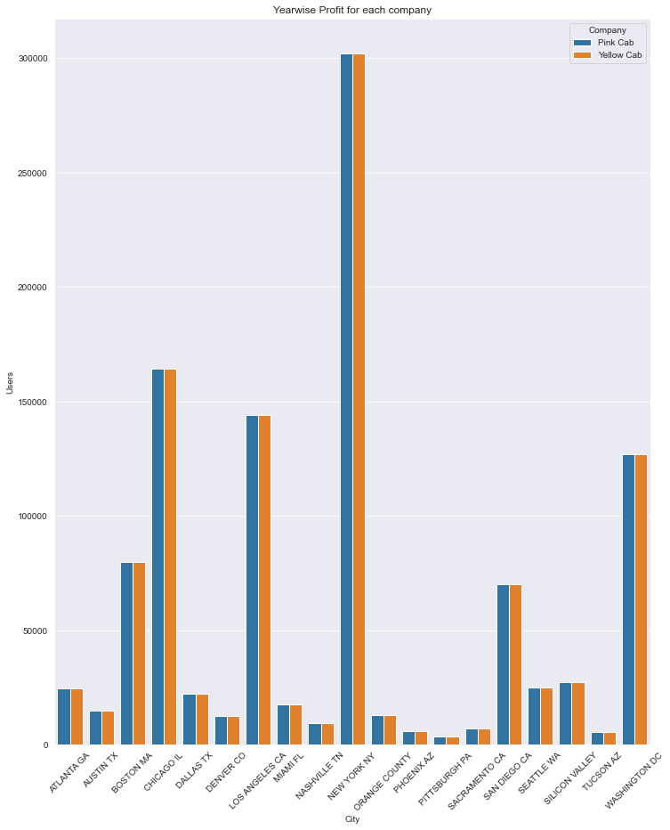
Multivariate Analysis
Yellow and Pink cab users are similar in citywise data

Slide 12
Recommendations
We woukd recommend Yellow cab for investment.

Slide 13
Thank You

